Slide 1
Drexel Marketplace
Hung Do
Kenneth Pan
Stefano Cadringher

Slide 2
Idea/Users
System Overview: An online platform enabling Drexel University students to buy and sell products within their community.
Purpose: Facilitate a safe, secure, and convenient environment for exchanging goods.
Target Users:
Primary: Drexel University students.
Secondary: Faculty and staff members.

Slide 3
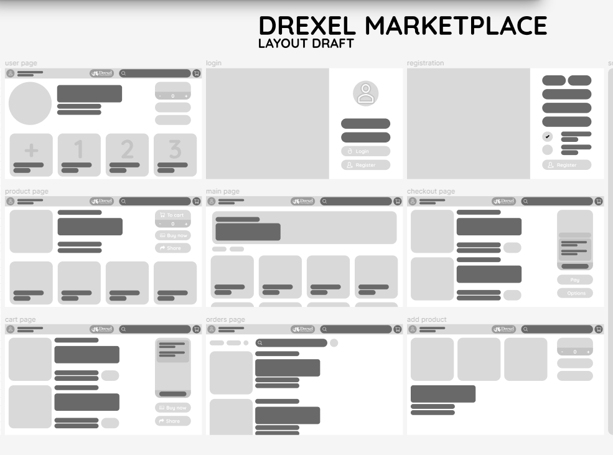
Prototype

Slide 4

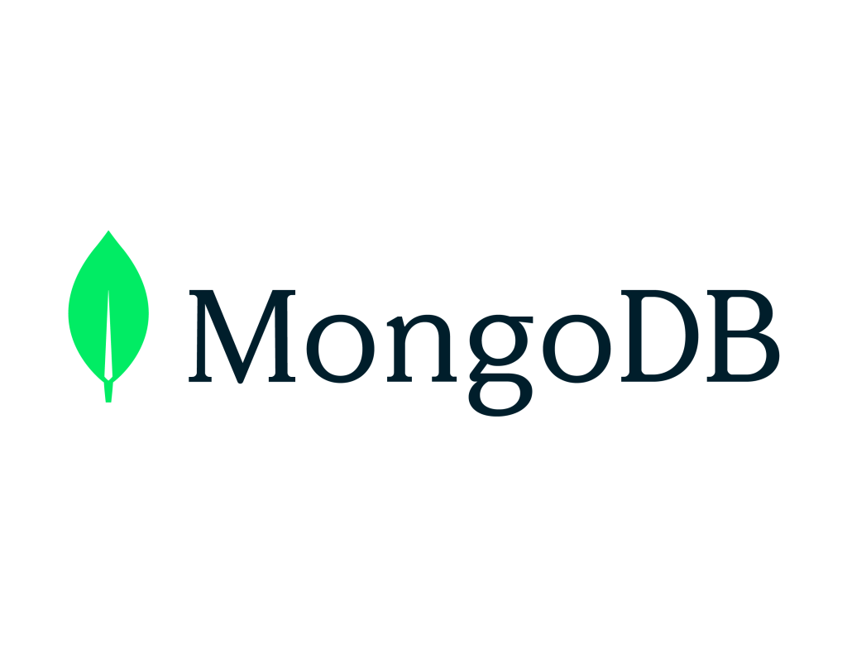

Implementation
Technologies Used: MEAN Stack (MongoDB, Express, Angular, Node)
Front-end: Angular for a dynamic and responsive user interface.
Back-end: Node.js with Express for server-side logic.
Database: MongoDB for storing user and product data.

Slide 5
Future work and more
Usefulness:
Reduces waste by promoting the reuse of items.
Saves money for students through second-hand deals.
Future work:
Mobile app version for iOS and Android.
Wishlist feature for tracking desired items.
Community forum for discussions and advice.

Slide 6
Project Demo

